Slide 1


Krish Aggarwal
18th May 2023

Slide 2

Outline
Executive Summary
Introduction
Methodology
Results
Conclusion
Appendix

Slide 3
Executive Summary
Summary of methodologies
Data collection
Data wrangling
EDA with data visualization
EDA with SQL
Building an interactive map with Folium
Building a Dashboard with Plotly Dash
Predictive analysis (Classification)
Summary of all results
EDA Results
Interactive Analysis
Predictive Analysis

Slide 4
Introduction
Project background and context : SpaceX advertises Falcon 9 rocket launches on its website, with a cost of 62 million dollars; other providers cost upward of 165 million dollars each, much of the savings is because SpaceX can reuse the first stage.
Problems you want to find answers : The project task is to predicting if the first stage of the Space Falcon 9 rocket will land successfully

Slide 5

Section 1

Slide 6
Methodology
Executive Summary
Data collection methodology:
SpaceX Rest API
Web Scrapping from Wikipedia
Perform data wrangling
One Hot Encoding data fields for Machine Learning and data cleaning of null values and irrelevant
columns
Perform exploratory data analysis (EDA) using visualization and SQL
Perform interactive visual analytics using Folium and Plotly Dash
Perform predictive analysis using classification models
LR, KNN, SM, DT models have been built and evaluated for the best classifier

Slide 7
Data Collection
The following datasets was collected:
Space launch data that is gathered from the Space
REST API.
This API will give us data about launches, including
information about the rocket used, payload delivered,
launch specifications, landing specifications, and
landing outcome.
The Space REST API endpoints, or URL, starts with
api.spacedata.com/v4/.

Slide 8
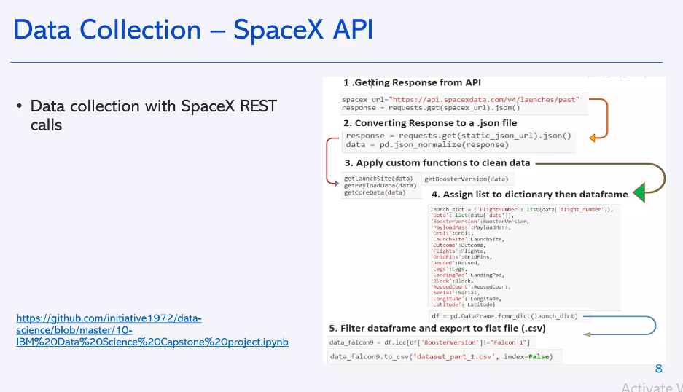
Data Collection – SpaceX API
Present your data collection with SpaceX REST calls using key phrases and flowcharts
Add the GitHub URL of the completed SpaceX API calls notebook (must include completed code cell and outcome cell), as an external reference and peer-review purpose
Place your flowchart of SpaceX API calls here

Slide 9
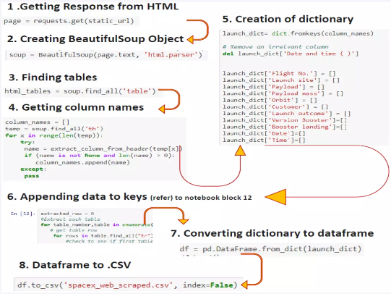
Data Collection - Scraping
Web scraping from wikipedia
httos://github.com/initiative 1972/data-science/blob/master/10-IBM%20D5%20Capstone %20project-lab 2-web %20scraping.ipynb
Place your flowchart of web scraping here

Slide 10
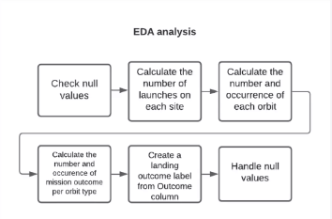
Data Wrangling
https://github.com/initiative1972/data-science/blob/master/10-IBM%20DS%20Capstone%20project-lab3-EDA.ipynb

Slide 11
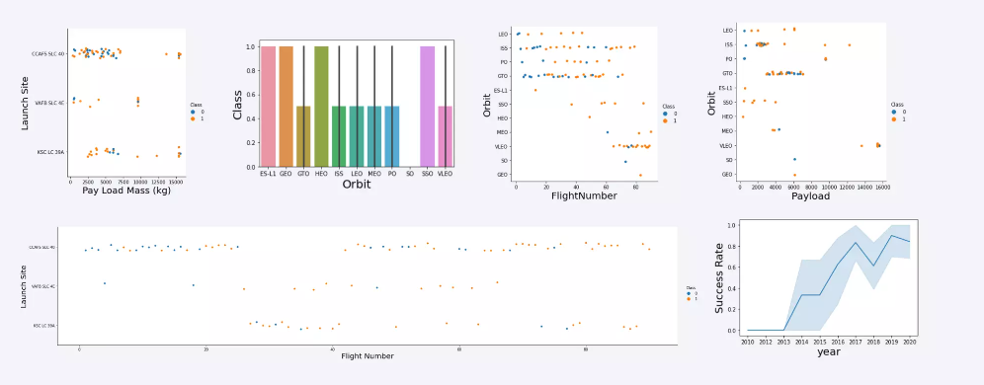
EDA with Data Visualization

Slide 12
EDA with SQL
SQL queries performed include:
isolaving the names of the unique launch sites in the space mission
Disolaving s records where launch sites begin with the string KS€
Disolaving the tota pavload mass carried ov boosters aunched oY NASA IORSI
Displaying average payload mass carried by booster version F9 v1.1
Listing the date where the successful landing outcome in drone ship was achieved
Listing the names of the boosters which have success in ground pad and have payload mass greater than 4000 but less than 6000
Listing the total number of successful and failure mission outcomes
Listing the names of the booster_versions which have carried the maximum payload mass.
Listing the records which will display the month names, successful landing outcomes in ground pad booster versions, launch site for the months in year 2017
Ranking the count of successful landing outcomes between the date 2010 06 04 and 2017 03 20 in descendingorder.
https://github.com/initiative 1972/data-science/blob/master/10-IBM-DS%20Capstone%20project-SQLipynb

Slide 13
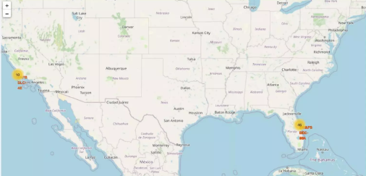
Build an Interactive Map with Folium
Map markers have been added to the map with aim to finding an optimal location for building a launch site
httos/github.com/initiative197/2/data-science/blob/master10-18M%2005%20Capstone-lab5-Folium.ipynb

Slide 14
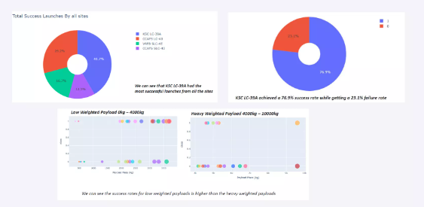
Build a Dashboard with Plotly Dash
https://github.com/initiative1972/data-science/blob/master/dash_interact2_HY.py

Slide 15
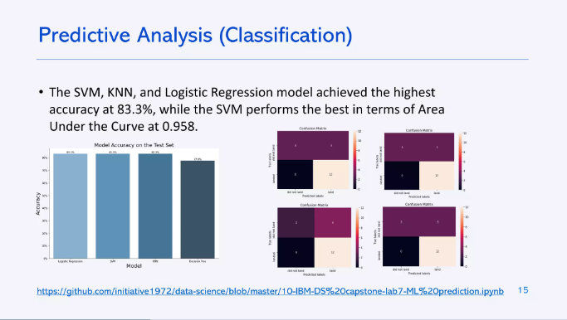

Slide 16
Results
• The SVM, KNN, and Logistic Regression models are the best in terms of
prediction accuracy for this dataset.
Low weighted payloads perform better than the heavier payloads.
•The success rates for Space launches is directly proportional time in years they
will eventually perfect the launches.
KSC LC 39A had the most successful launches from all the sites.
• Orbit GEO,HEO,SSO,ES L1 has the best Success Rate.

Slide 17

Section 2

Slide 18
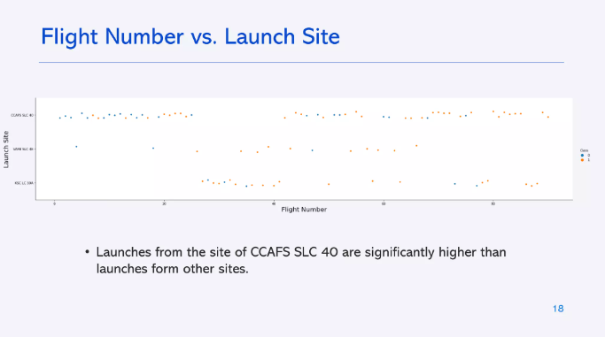

Slide 19
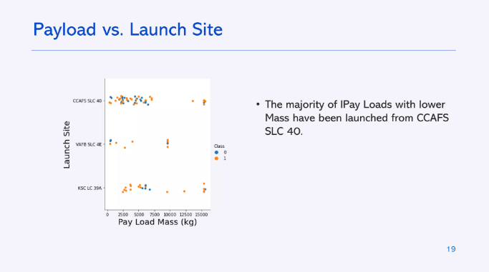

Slide 20
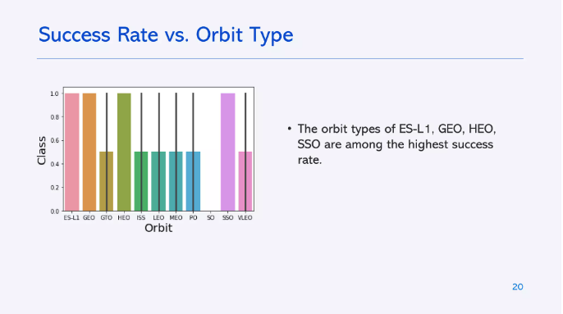

Slide 21
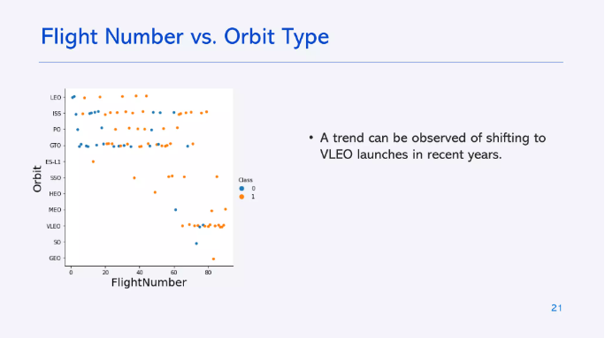

Slide 22
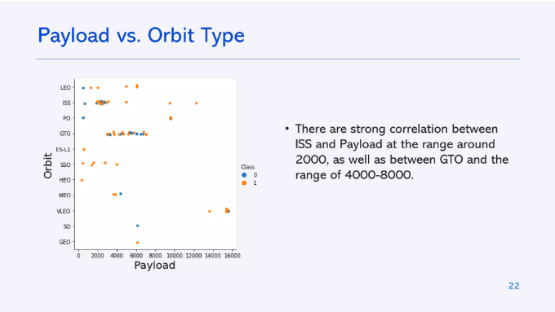

Slide 23
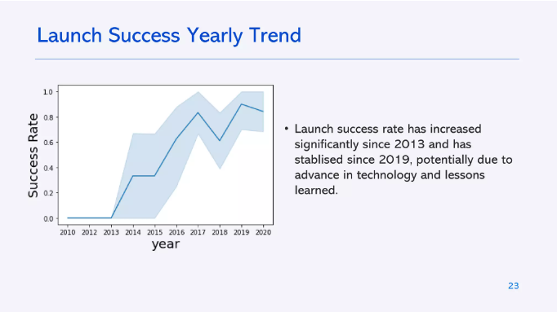

Slide 24
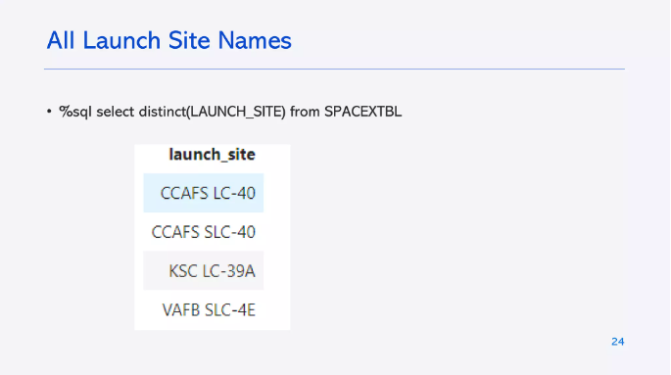

Slide 25
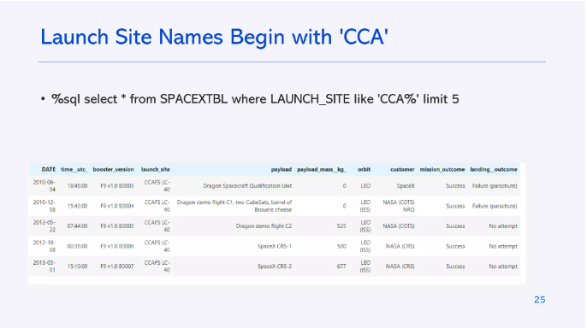

Slide 26
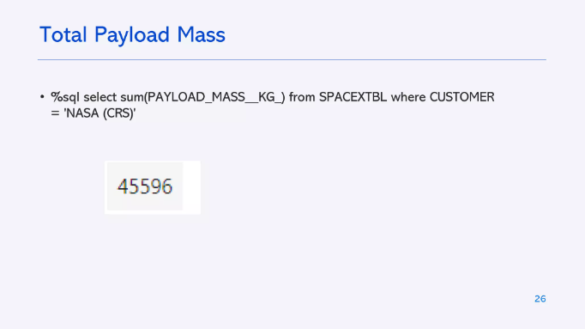

Slide 27
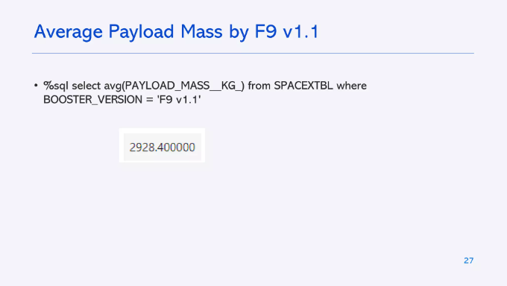

Slide 28
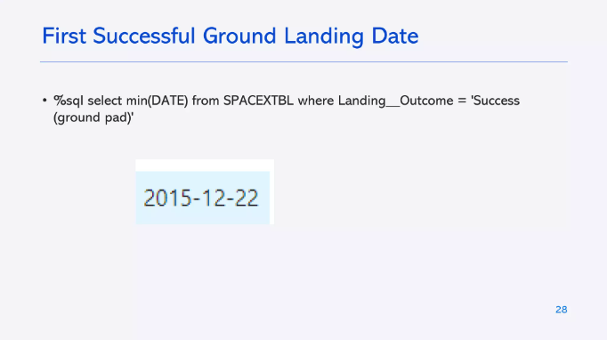

Slide 29
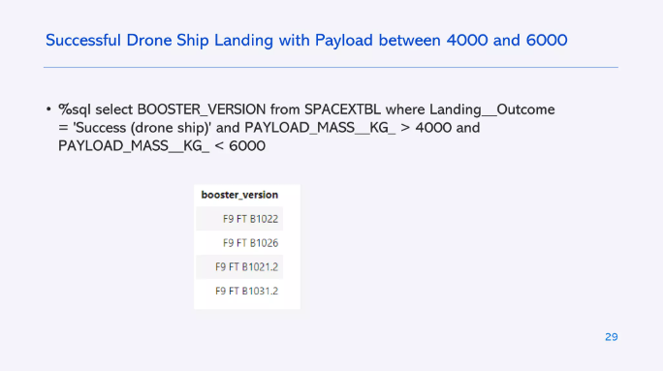

Slide 30
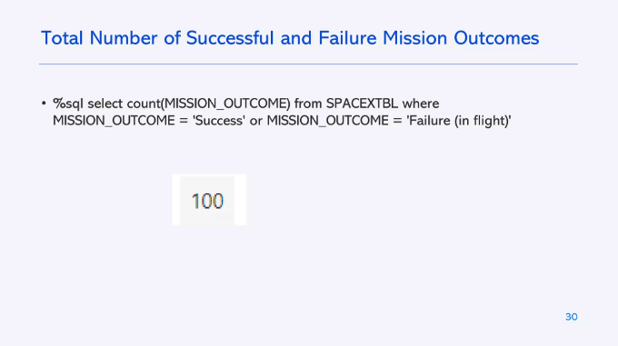

Slide 31
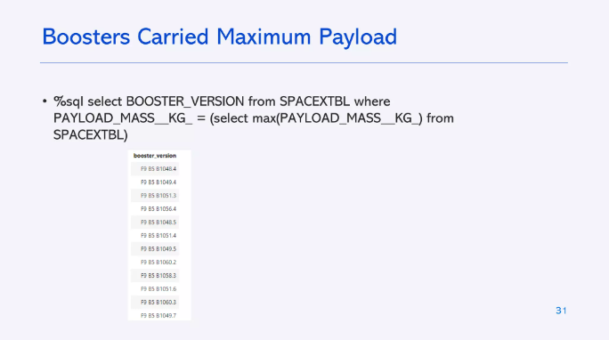

Slide 32
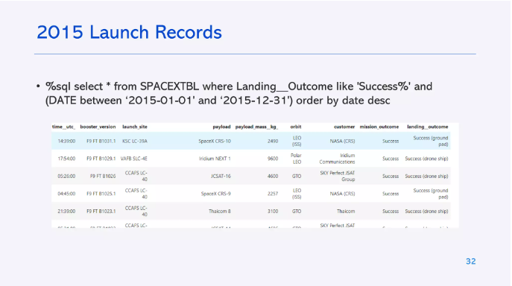

Slide 33
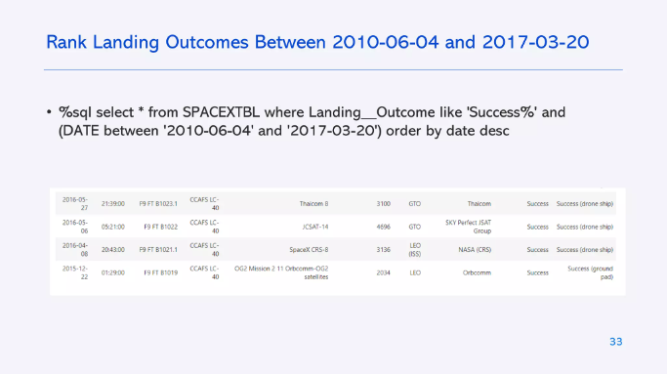

Slide 34

Section 3

Slide 35
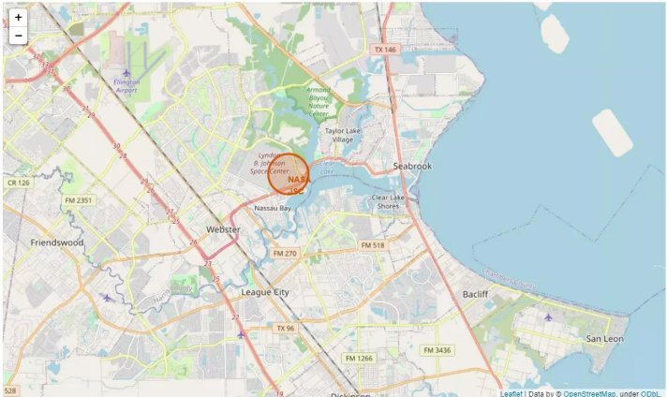
All launched sited marked on map

Slide 36
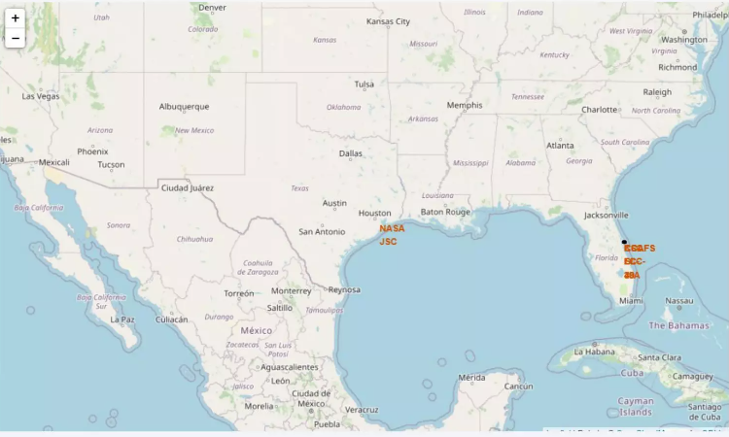
Succes/Failed launches marked on map

Slide 37
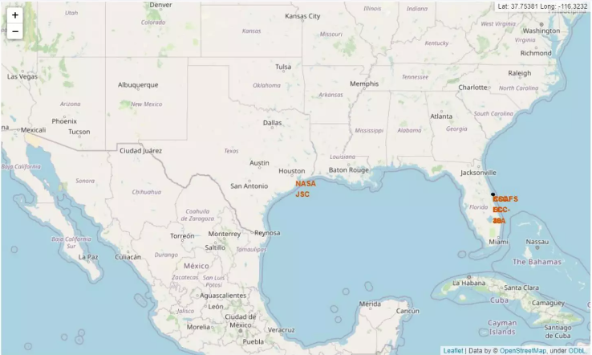
Distance between launch site to its proximities

Slide 38

Section 4

Slide 39
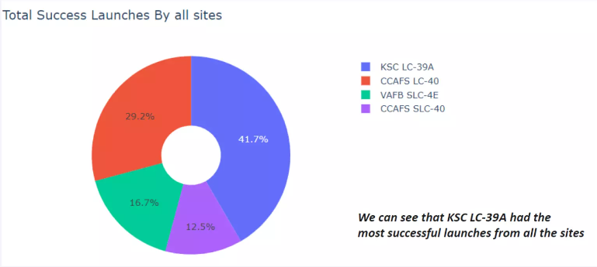
Total success launches by all sites

Slide 40
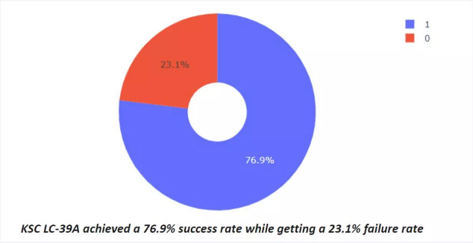
Success rate by site

Slide 41
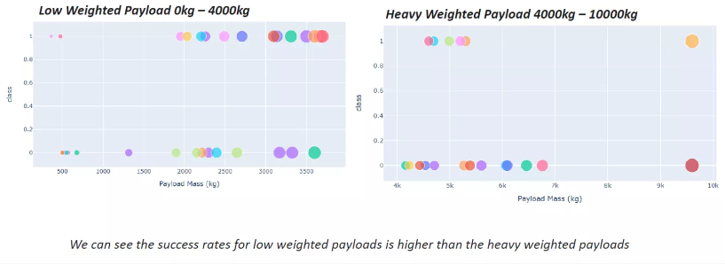
Payload Vs Launch Outcome

Slide 42

Section 5

Slide 43
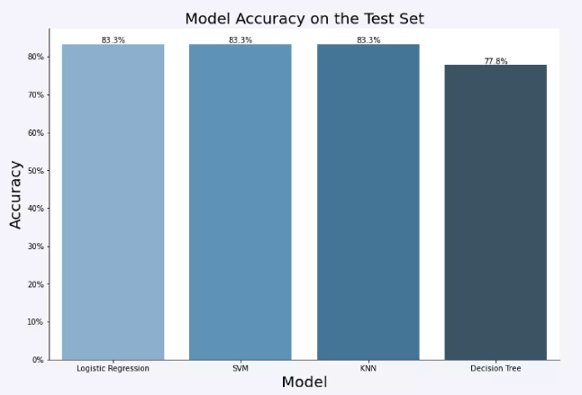
Classification Accuracy

Slide 44
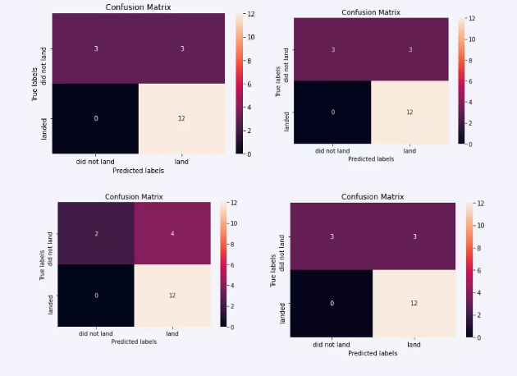
Confusion Matrix

Slide 45
Conclusions
• The SVM, KNN, and Logistic Regression models are the best in terms of prediction accuracy for this dataset.
• Low weighted payloads perform better than the heavier payloads.
• The success rates for Space launches is directly proportional time in
years they will eventually perfect the launches.
• KSC LC 39A had the most successful launches from all the sites.
• Orbit GEO,HEO,SSO,S L1 has the best Success Rate.

Slide 46
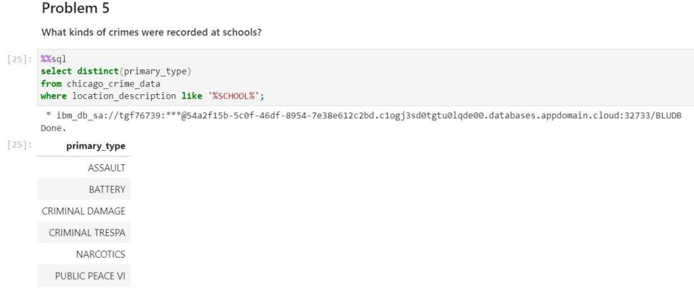
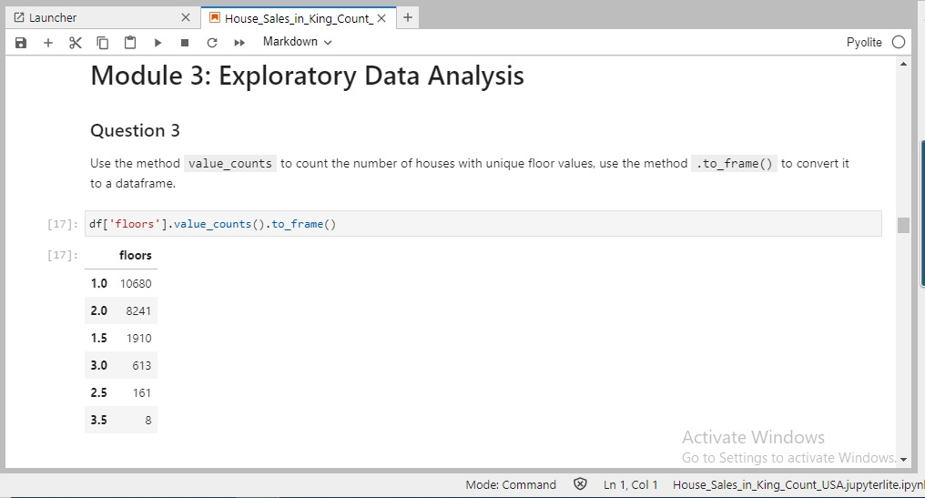
Appendix
Include any relevant assets like Python code snippets, SQL queries, charts, Notebook outputs, or data sets that you may have created during this project

Slide 47


